Slide 1
An Empirical Comparison between Traditional Banks and Peer-to-Peer Lending Companies
Jeffers Yin, Jin Sun, Vicky Xu, Shunli Lu

Slide 2
1
Overview
2
Borrows’ Perspective
Contents
3
Investors’ Perspective
4
Additional Findings
5
Conclusion

Slide 3

01
PART ONE
Overview

Slide 4
01
Our Framework
Bank
P2P
Simulate default prob P using ML
Simulate Rate using Prosper dataset by ML
Borrower
Use P and risk-neutral pricing, generate the estimated Rate
A ML product selection tool powered by a metrics that maximizes investor utility
Investor
Others
Additional research

Slide 5
01
Our Framework
Bank
P2P
Our Approach
Simulate default prob P using ML
Simulate Rate using Prosper dataset by ML
Compare rate on individual level
Conclude insights
Provide recommendations
for best financing strategy
Borrower
Use P and risk-neutral pricing, generate the estimated Rate
A ML product selection tool powered by a metrics that maximizes investor utility
A metrics considering personal preference
Use a survey to gain the training dataset(cannot be done currently)
Use the dataset to train a ML model
that assign proper product to investors
where utility is maximized
Investor
Others
Additional research
Shed some light on both fund supplier and demander via ML models

Slide 6
02
Our Data
Prosper dataset
FDIC dataset
Contains more than 100,000 rows of individual-level loan data.
Contains all the performance ratios of depository institutions supervised by FDIC

Slide 7
02
Our Models
Methodology
Quantity
We used machine learning models as primary approach to deal with the data.
Three different ML models are well developed in our research for different purposes.
Quality
Types
By tuning our models with different sets of parameters, we reached significant accuracy.
In terms of ML models we used, Random Forest and Boosted Trees are what we used ultimately.

Slide 8
02
PART TWO
Borrowers’ Perspective

Slide 9

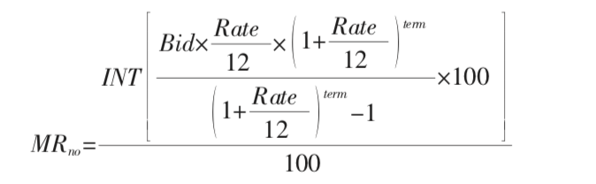
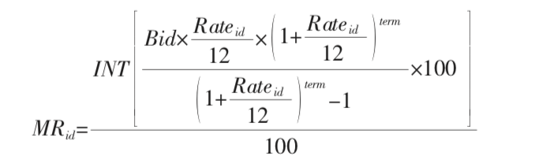
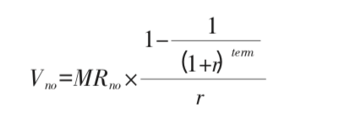
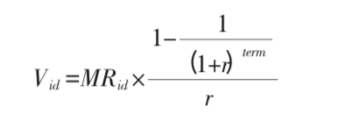
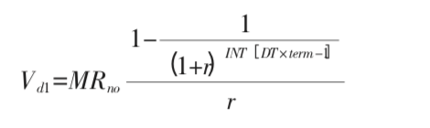
02
Risk Neutral Model --- Formulas
Risk Neutral Model:
Monthly Repayment:
Total Present Value of Monthly Repayment without default:
Total Present Value of Monthly Repayment with default:

Slide 10
02
Risk Neutral Model --- Results
Occupation | Risk-neutral Rate | Real Average Rate | Difference
IT | 19.7% | 17.0% | -2.7%
Executive | 16.5% | 17.4% | 0.9%
Professional | 18.3% | 18.9% | 0.6%
Food Service | 20.7% | 21.5% | 0.8%
Laborer | 18.4% | 21.1% | 2.7%
Fireman | 17.6% | 19.3% | 1.7%
Analyst | 18.3% | 17.9% | -0.4%
Architect | 19.7% | 16.6% | -3.1%
Teacher | 19.0% | 19.5% | 0.5%
Waiter / Waitress | 21.3% | 21.7% | 0.4%

Slide 11
02
Risk Neutral Model --- Results
State | Risk-neutral Rate | Real Average Rate | Difference
IL | 18.8% | 18.7% | -0.1%
NY | 18.6% | 19.1% | 0.5%
OH | 19.6% | 20.0% | 0.4%
TX | 17.4% | 18.9% | 1.5%
CO | 18.1% | 18.7% | 0.6%
MO | 20.5% | 20.1% | -0.4%
LA | 20.2% | 20.1% | -0.1%
CA | 17.5% | 18.7% | 1.2%
MD | 19.4% | 19.8% | 0.4%

Slide 12
03
Investors’ Perspective
PART THREE

Slide 13
03
Utility-Maximization Model
STEP ONE:
STEP TWO:
Design a survey to collect data from professional investment manager with different level of risk tolerances and their investment choice
Use data to train classification models through machine learning models such as gradient boost random forest, logistic classification etc.
STEP THREE:
Implement model to make the best investment decisions across various financial products

Slide 14




03
Survey Metrics
Investing Experience
Investment Objective
Asset/Capital
Risk Tolerance
How much do you spend on investment previously?
What is your expected rate of return?
What is your income level?
Protecting my portfolio is more important to me than high returns?

Slide 15
03
Ideal Model Example
Survey Metrics
Investing Experience
Investment Objective
Capital
Utility Model
Transfer survey data into model
Risk Tolerance
Investment Strategy
Stocks
Bonds
ETF
Fix income etc.
Deposit
P2P

Slide 16
04
PART FOUR
Additional Findings

Slide 17
04
The Basic Idea
Empirical view of variables that have an impact on interest rate from the fund supplier side, which are banks, and the fund demander side, which are borrowers.
The results from the analysis are not comparable because one is based on the bank-level, and the another is based on the individual-level.

Slide 18
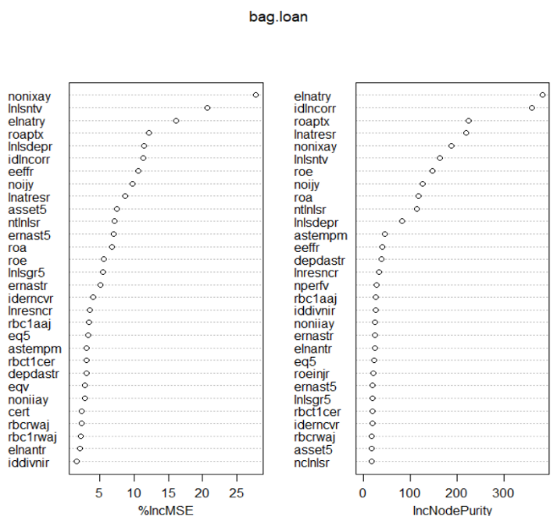
04
FDIC
Annualized loss on loans and leases to total assets ratio is the most significant variable when determining the interest rate level of a bank.
Relative amount of loans and leases and relative size of pre-tax net income are also functioning importantly.

Slide 19
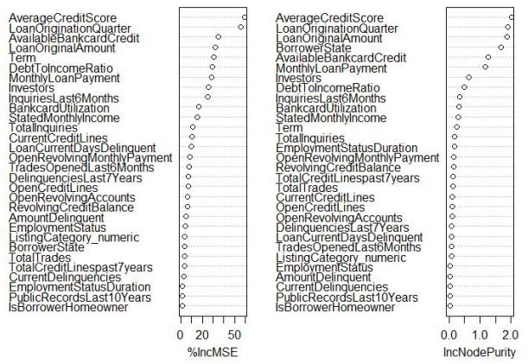
04
Prosper
Average credit score and loan issuing quarter are the two most significant variables of borrowers.

Slide 20
05
PART FIVE
Conclusion

Slide 21
05
Borrowers' Perspective
Laborer and fireman had relatively higher interest rate, which might be caused by the lack of public confidence in their work stability
Texas and California had relatively higher interest rate, which might come from the instability of start-ups or the automatic market adjustment
Those “discriminated” groups should consider other sources of loans

Slide 22
05
Investors' Perspective
Average credit score and loan issuing quarter are the two most significant variables of borrowers when determining their rates.
So far we have only described the relationships from a predicting perspective.
Further studies of causal inference would be critical in terms of finding the underlying mechanisms.

Slide 23
Thank You

